Slide 1


Directorate of IT
University of Malakand
Student Record
Updation
https://cms.uom.edu.pk

Slide 2
Content
01
02
03
04
Access CMS
Odoo CMS Module
Update Student Record
Cancel Student Admission on CMS

Slide 3
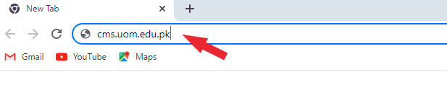
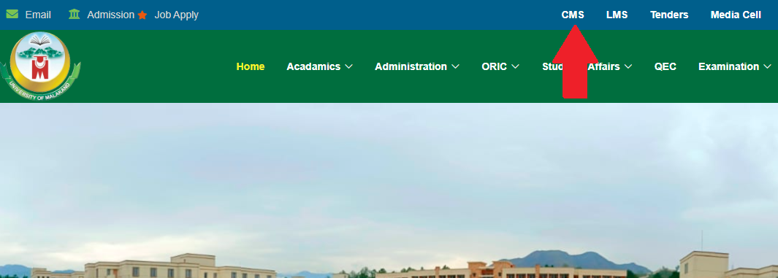

Access CMS
Through URL
Open a web browser (Google Chrome, Firefox, Microsoft Edge) whatever you use. When a browser is open type the following URL:
https://www.uom.edu.pk/
Through University website
Open university website, click on CMS in the
top menu, it will navigate you to the
login page.
CMS

Slide 4
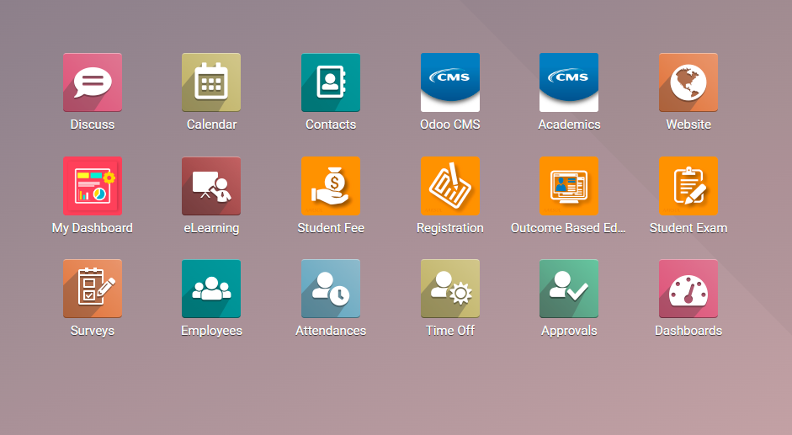

Odoo CMS Module
To update student records, we use the Odoo CMS module. The module contains student records. To update student data, such as email, CNIC, phone number, gender, etc., we use this module.

Slide 5
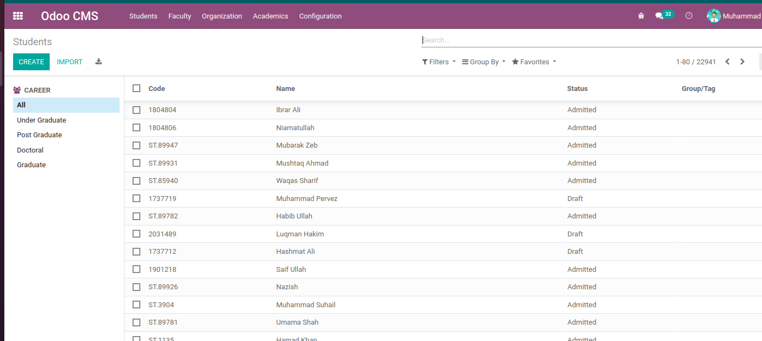
Update/Correct Student Record
Navigation:
Open CMS Module>>Search student Record.
Open the CMS module and search for the student record you want to update

Slide 6

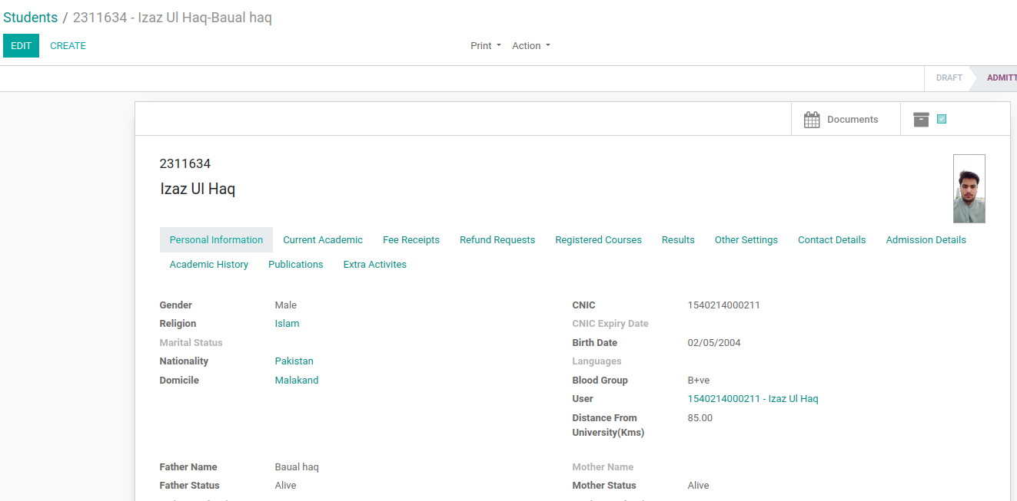
Open the student record and click on the "Edit" button. The fields will become editable. Update or correct the information as needed, then save your changes.

Slide 7
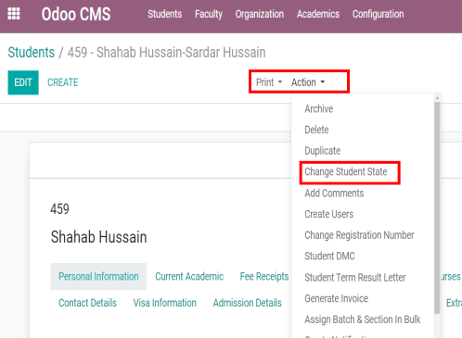
Cancel Student Admission
To cancel a student's admission in the CMS, use the same Odoo CMS module. Search for the student whose admission you want to cancel. Open their record.
In the form view, you will see an "Action" button. Click on it, and a dropdown will appear with multiple options. Select "Change Student State."

Slide 8
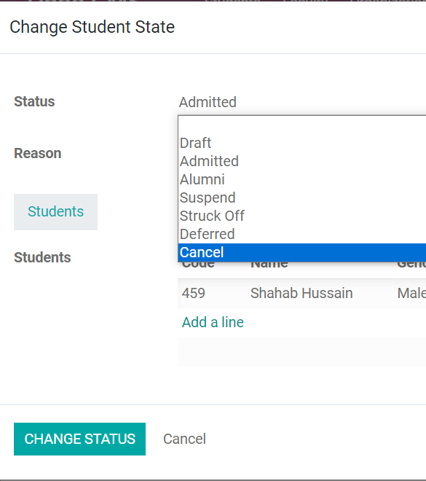
After clicking on the "Change Student State" button, a new form will open containing the field Status.
Select Cancel and click on the CHANGE STATUS button. The student's status will be updated to "Cancelled."

Slide 9
THANK TOU
For watching this presentation

